Slide 1
Boxing Stats
Gerardo Rodriguez, Christian Quinonez

Slide 2
System Description
Our project will be a simple website
The website will show different stats from fighters, coaches, and referees
User will be able to sort through what they want to view
User can add different stats to view

Slide 3
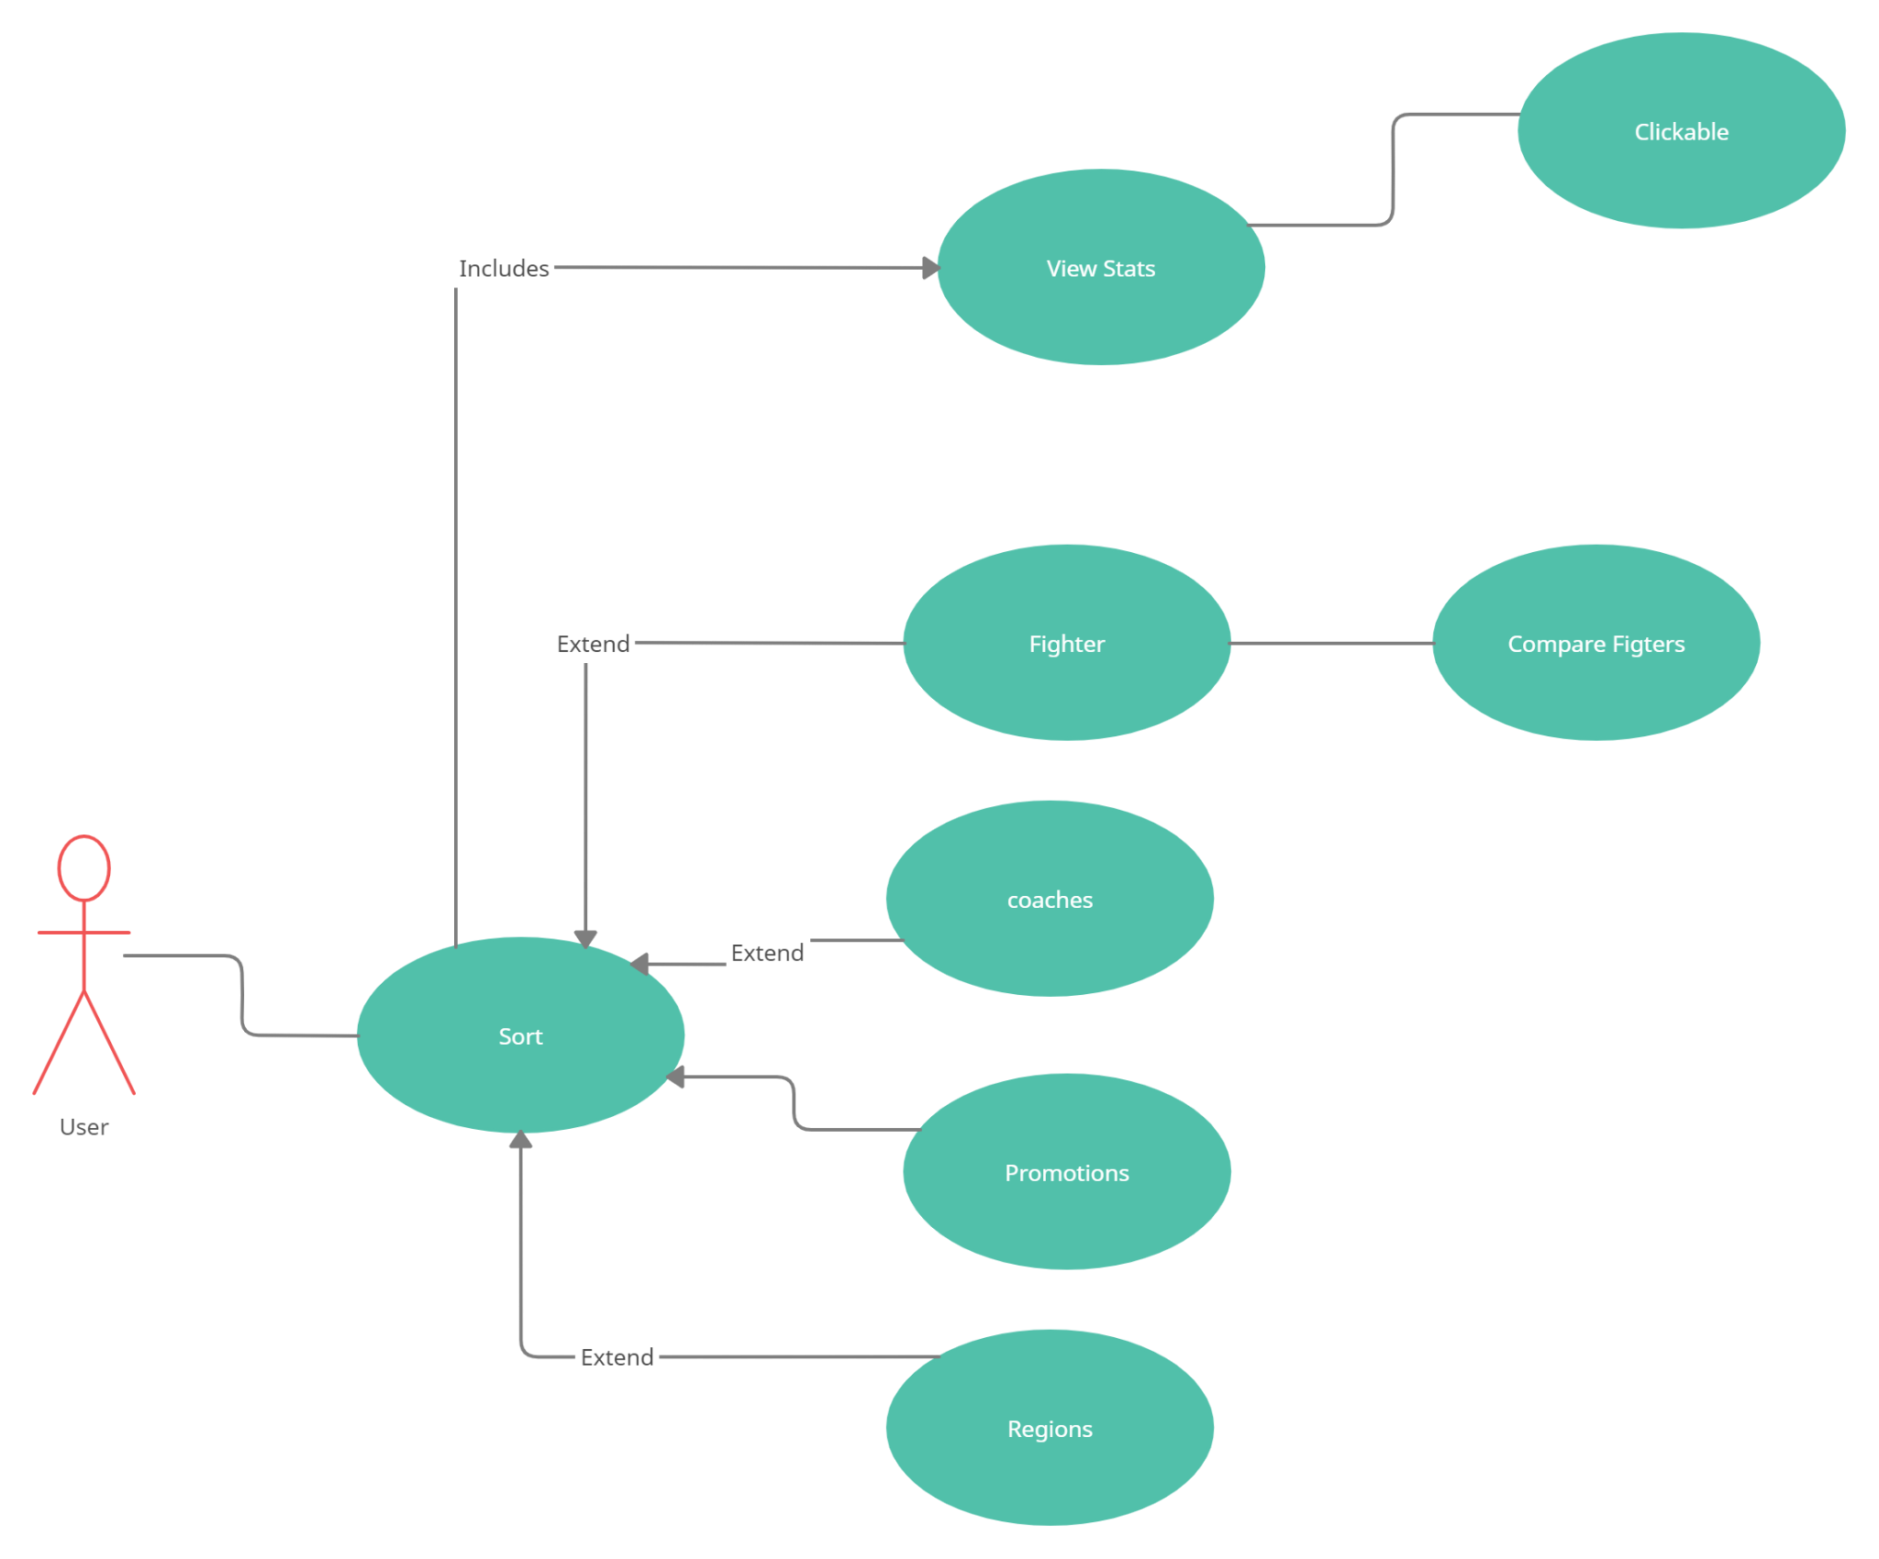
USE case diagram

Slide 4
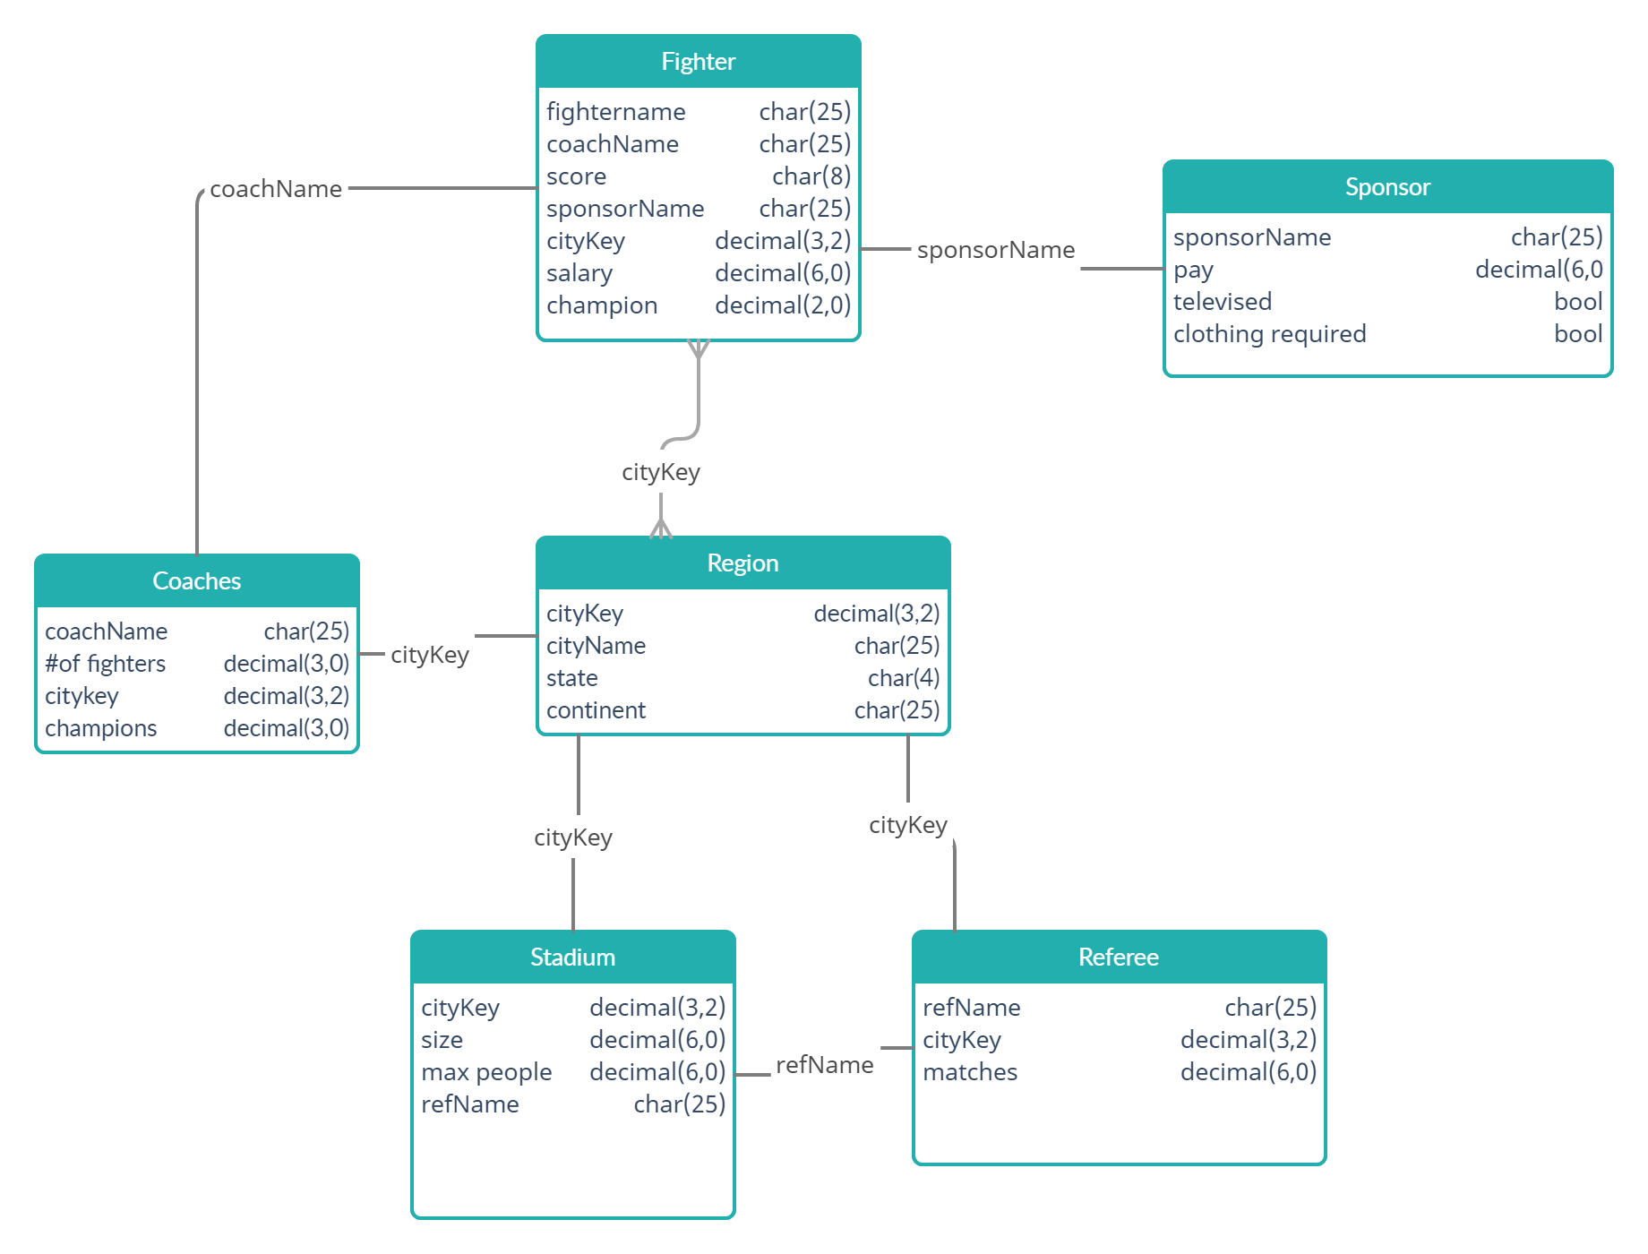
E/R diagram

Slide 5
Relational Schema
Fighter
f_fighterName, f_coachName, f_score, f_sponsorName, f_cityKey, f_salary, f_champion
Region
r_cityKey, r_cityName, r_state, r_continent
Coach
c_coachName, c_numoffighters, c_cityKey, c_numofchamps
Stadium
s_cityKey, s_size, s_maxpeople, s_refName
Referee
rf_refName, rf_cityKey, rf_matches
Sponsor
sp_sponsorName, sp_pay, sp_televised, sp_clothingrequired

Slide 6
Implementation details
Integrated Development Environment
Visual studios
Database
SQLite3
Languages
HTML
SQL
C++ or Javascript?

